Slide 1

SAFRAN engineering services C++ programming under DO178 - 332

Slide 2
C++ programming under DO178 / DO332 Course organization
Planning |  |  | Teatcher | Content | Room
12/12/2017 | 10h15 | 12h15 | Manon | Presentation of DO178 / DO 332 Practical work on landing gear monitoring system | Caud07
12/12/2017 | 13h15 | 15h15 | Manon | Practical work on landing gear monitoring system specification | D202
19/12/2017 | 13h15 | 15h15 | Dupouy | Recall on C++ basics Zoom on DO 332 (review of main FAQ in DO332) | D202
19/12/2017 | 15h30 | 17h30 | Dupouy | Practical work on landing gear monitoring system class modelling / C++ coding / testing | D202
10/01/2018 | 10h15 | 12h15 | Dupouy | Practical work on landing gear monitoring system class modelling / C++ coding / testing | D203
10/01/2018 | 13h15 | 15h15 | Dupouy | Practical work on landing gear monitoring system class modelling / C++ coding / testing | D203
17/01/2018 | 10h15 | 12h15 | Dupouy | Practical work on landing gear monitoring system class modelling / C++ coding / testing | D205
17/01/2018 | 13h15 | 15h15 | Dupouy | Practical work on landing gear monitoring system class modelling / C++ coding / testing | D205
22/01/2018 | 10h15 | 12h15 | Dupouy | Practical work on landing gear monitoring system class modelling / C++ coding / testing | D205
22/01/2018 | 13h15 | 15h15 | Dupouy | Exam | D205

Slide 3
Objectives
Main pedagogical objectives:
To get acquainted with the basis of object coding for critical software
To be able to realize simple coding using C++
Detailed pedagogical objectives:
To get acquainted with critical software
To get acquainted with DO178C norm and related refinements
To get acquainted with DO178C process
To get acquainted with DO332
To get acquainted with the concept of Configuration management and Modification management
To get acquainted with the use of manual coding versus automatic coding

Slide 4

DO178C : Synopsis of the course on DO178
Difference between software and critical software
Different DO norms for different purpose
DO178C: Purpose
DO178C: Historic and refinements
DO178C: Different levels of criticism (DAL A to E)
DO178C: Process and Life Cycle
Manual coding versus Automatic coding
Overview on modification management
Overview on configuration management
DO178C : Objectives
DO178C : Zoom on DO332
DO332: main principles
DO332: FAQ

Slide 5

Difference between software and critical software
Definition:
Software: the programs used to direct the operation of a computer, as well as documentation giving instructions on how to use them
Critical software:
→ No failures accepted, i.e. initial safety analysis is led to define the acceptable level of failures for the system (measured as probability < 10^{x} )
Definition of a process (full life cycle) to get no failures
Definition of a norm precognizing objectives and activities to be performed

Slide 6
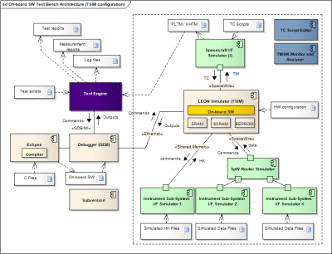
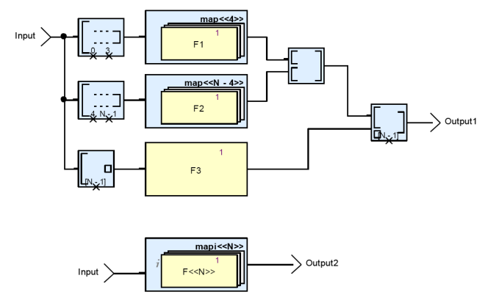
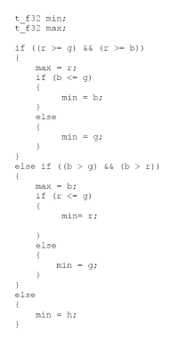
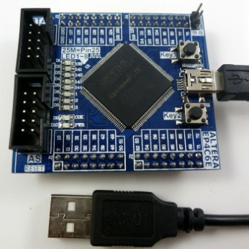
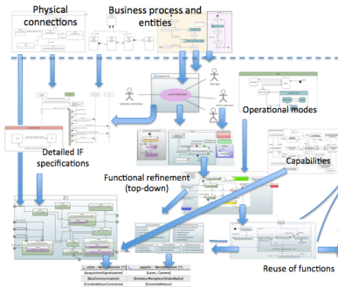
Different DO norms for different purpose
DO178 and all refinements (cf. next slide)
→ Software Architecture, Development
DO254 / DO160
→VLSI Design and Verification for FPGA, ASIC and SoC Components
ARP4754
→ System-level Design, Verification and Validation

Slide 7

DO178C : Purpose
DO-178C, Software Considerations in Airborne Systems and Equipment Certification provides guidance for developing airborne software
DO-178C is the primary document by which the certification authorities such as FAA or EASA approve all commercial software-based aerospace systems
DO-178C was published by RTCA (Radio Technical Commission for Aeronautics) Incorporated, in a joint effort with EUROCAE (The European Organisation for Civil Aviation Equipment)
DO-178C/ED-12C was completed in November 2011

Slide 8
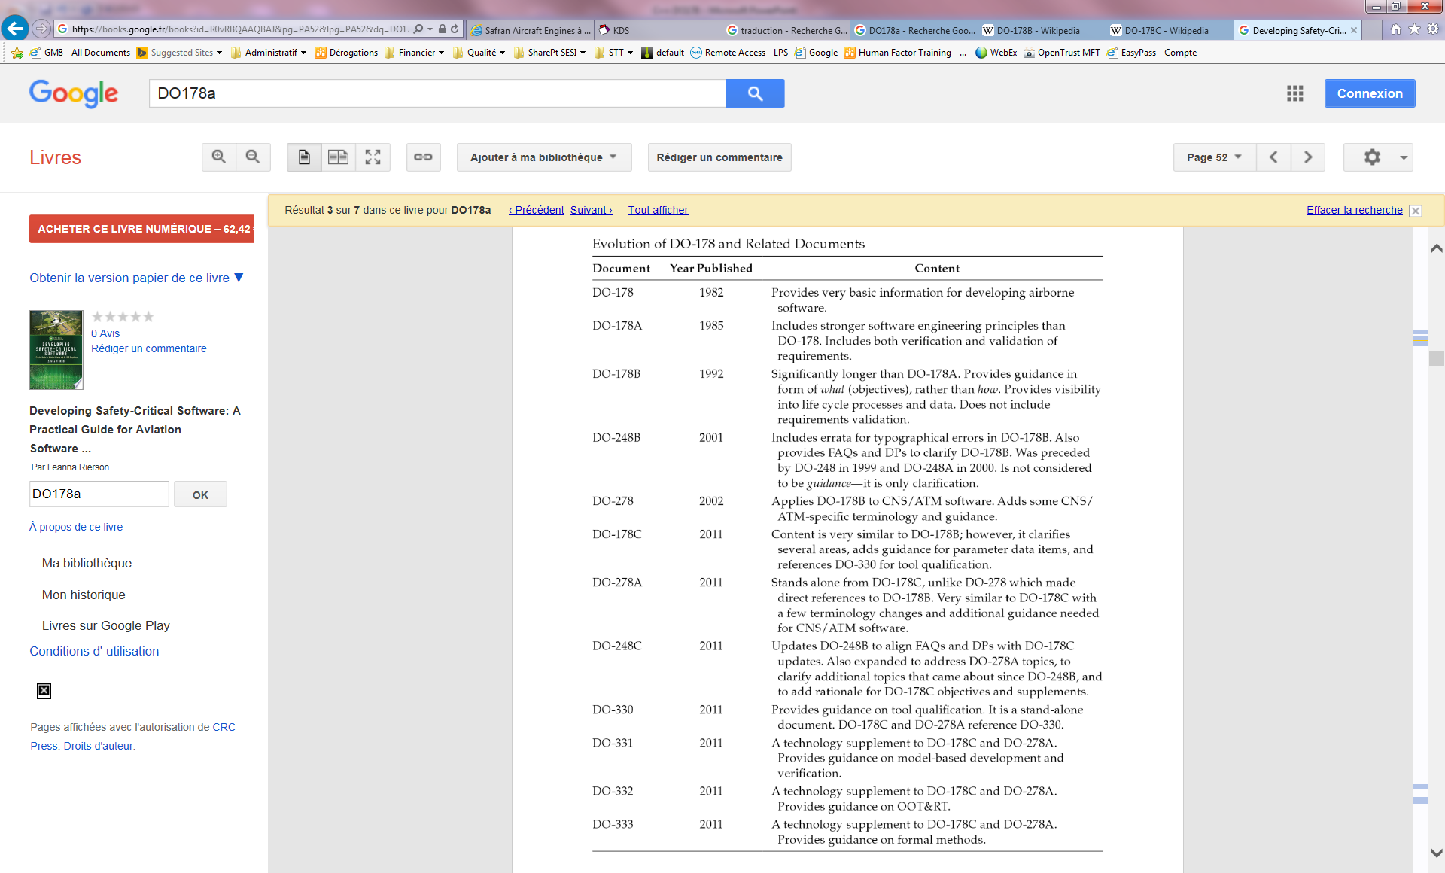
DO178C : Historic and refinements
Basis
Add V&V principles
Guidance instead
of rules
Clarifications
on DO178B
Dedicated to CNS/ATM
Context (communication, navigation
systems and air traffic management)

Slide 9
DO178C : Historic and refinements
Clarifications + dedicated
DO330 for tool qulification
Evolutions
Evolutions
Dedicated to tool
qulification
Dedicated to model
based development
Dedicated to OOT
Dedicated to
formal methods

Slide 10
DO178C : Different levels of criticism (DAL A to E)
Design Assurance Level (DAL) is determined by examining the effects of a failure condition in the system.
Catastrophic - Failure may cause multiple fatalities, usually with loss of the airplane.
Hazardous - Failure has a large negative impact on safety or performance, or reduces the ability of the crew to operate the aircraft due to physical distress or a higher workload, or causes serious or fatal injuries among the passengers.
Major - Failure significantly reduces the safety margin or significantly increases crew workload. May result in passenger discomfort (or even minor injuries).
Minor - Failure slightly reduces the safety margin or slightly increases crew workload. Examples might include causing passenger inconvenience or a routine flight plan change.
No Effect - Failure has no impact on safety, aircraft operation, or crew workload.
Level | Failure condition | Objectives | With independence
A | Catastrophic | 71 | 33
B | Hazardous | 69 | 21
C | Major | 62 | 8
D | Minor | 26 | 5
E | No Safety Effect | 0 | 0

Slide 11

Overview on modification management
CR development or update
(CR “Assigned”)
CR review is correct?
Transmitted to Provider by ECM
Provider
KO
OK
Customer
CR estimation
Transmitted to Customer by ECM
Agreement with estimation?
KO
OK
Record the CR in the implementation follow-up (file used to monitor the implementation of HLR / CR)
CR implementation and verification
Update the CR in the CR implementation follow-up (CR “Completed”)

Slide 12
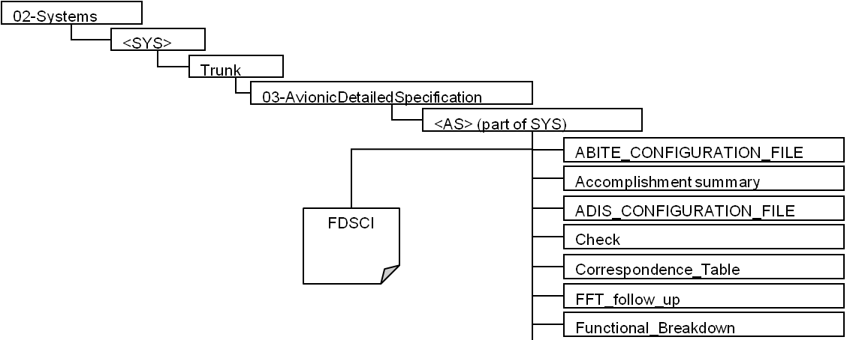

Overview on configuration management and modification management
Configuration management
The configuration management process aims to identify all the items of the project in order to control their lifecycle, the following of modifications and problem corrections.
Organization of project directory
Example

Slide 13
Overview on configuration management and modification management
Identification rule of project documents and tag delivery
The formal tag name is defined as follows, according to DA4 at §3.2.2.2:
DELIVERY_<Partition name>_<M>_<DATE>_<Version>
Where:
Partition name is defined in §2.1.3.2
M is the maturity of the delivery, [STDx, SCADE100] where x is the sprint number
The date format is yyyymmdd
Version is the current developpement standard, [S0A, S0B, S1A, S1B, S2A, S2B, ...]
Example
Rule of document versioning
For SENS plans tag, the rule consists to use identification (see 2.3.2) and to add version as follows:
Vxy, x∈[A…Z] and y∈[1…N] : for intermediary versions
x, x∈[A…Z] for validated versions
Example

Slide 14


DO178C : Process
Tout au long du projet : Audit processus
Suivi des Actions
Suivi des PR
Soutien DO178B au projet
Appel d’offre
SOI1
SOI2
SOI3
SOI4
Revue de lancement
Revue de Conformité
PLANS
Lecture des Plans
Revue de Test
Revue de Plans
Validation et
Inspection TA
Spécifications
Tests Intégration
Validation et Inspection Spécification
Revue de Test
Revue de spécification
Validation et Inspection TI
Architecture
Tests Fonctionels
Validation et Inspection Architecture
Revue de Test
Revue de l’architecture
Validation et Inspection TU
Validation et Inspection Conception
Conception
Tests Unitaires
Revue de Conception
Revue de Code
Validation Code et Inspection Code
Code
Notes:
To get acounted with:
V-Cycle
SOI
Phases
Acceptance criteria
Transitions

Slide 15
Manual coding versus Automatic coding
Automatic coding : applicative software

Slide 16

DO178C : Coding Process description
Activity: To verify CSUs code for a QACG CSC
Objectives: To verify the Source code
Responsibility: SVVL is responsible for this activity
Entry criteria: The inputs are released and managed under CM The CSC/CSUs Models are reviewed by technical and quality team (with no open blocking issue) The development tool Matlab/Simulink code generator is qualified
 | DAL
Inputs | B
CSC Matlab/Simulink code generation procedure | M
CSC Matlab/Simulink code generation report | M
Outputs | B
TC on CSC Matlab/Simulink code generation procedure | I
TC Matlab/Simulink code generation | M
Roles/Tasks
Software verification team | B
To perform the CSC Matlab/Simulink code generation procedure TC | I
To update the Matlab/Simulink code generator tool errata analysis | M
To analyze the CSC Matlab/Simulink code generation report | M
To perform the TC Matlab/Simulink code generation | M
Closure criteria: TS-TRR accepted, CDR accepted
Methods/Rules/Guidelines
Technical check Tool errata analysis Tool warning analysis

Slide 17
DO178C : Coding Process verification
1.To verify the code (MCP process)” activity
Prerequisites
The inputs are configuration managed.
SEnS starts the activity after SDDD maturity assessment performed with §0: To verify the LLR.
Planning baseline is approved.
Activity
To perform Code technical check:
Different points to check are:
Traceability with upstream document(s)
Conformity with standard
Consistency
Accuracy
Compliance with upstream document(s)
Testability, Verifiability
These checks are done using the checklist related to this activity and automatic check (results of automatic check are configuration managed).
Input data | Output data
PMP SDDD Source code files (.c, .h) Building procedures Products files (.o, .a) Traceability LLR <-> code document Standard: C language programming rules [DA09] | code CL

Slide 18
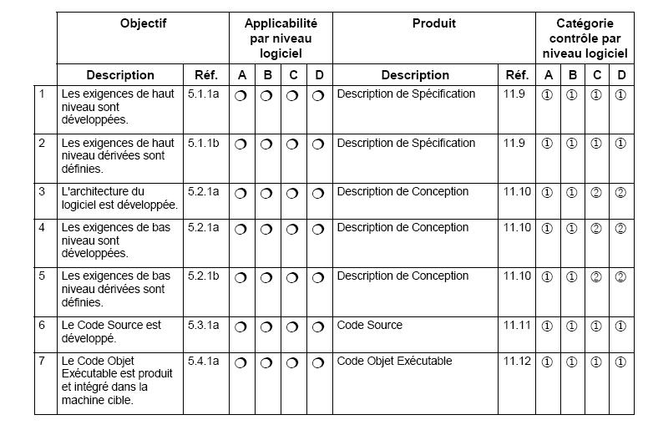
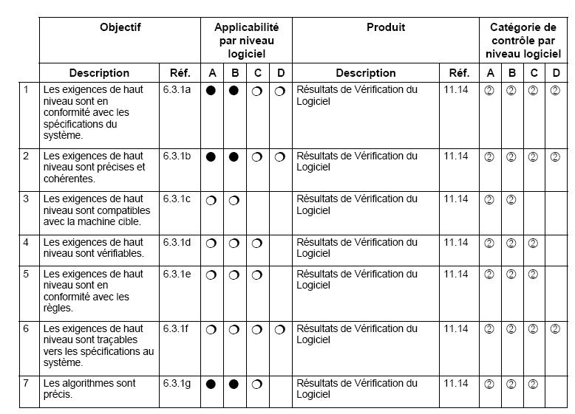
DO178C : Objectives
What does it mean → 2 soft engineer will write the same code?
How can it be measured? What are the criterion?
Need more explanations concerning Classes and Objects,
encapsulation, polymorphism …
Process design
Process verification
Some of the objectives are too general to be in line with the problematic encountered when coding with OOC → refinement realized in DO332

Slide 19
DO178C : Zoom on DO332
Modified objectives include:
• Software architecture is compatible with high-level requirements (section
OO.6.3.3.a).
• Software architecture is consistent (section OO.6.3.3.b).
• Source Code complies with software architecture (section OO.6.3.4.b).
• Source Code is accurate and consistent (section OO.6.3.4.f).
Additional objectives include:
• Verify local type consistency (section OO.6.7.1).
• Verify the use of dynamic memory management (section OO.6.8.1)
➔ No instantiation of objects allowed when running the program (C++, Java, ADA)
Creation of segregation using the concept of hypervisors and several virtual machines, in case of crash, only one virtual machine is impacted
Additional activities include:
• Executable Object Code complies with high-level requirements (section
OO.6.4.2.1.e).
• Executable Object Code complies with low-level requirements (section
OO.6.4.2.1.e).

Slide 20

DO178C : Example of modified objectives in DO332
1.Memory allocation
OO languages brings dynamic memory allocation.
But on critical system, the memory allocation has to be controlled to prevent memory leaks.
In DO332, dynamic memory is not forbidden, but the choice depends on the effort on resources analysis (memory analysis).
if the runtime brings a garbage collector, so the effort is on the runtime certification
If not (this is the case of C++), you have to make memory analysis.
→ to reduce this, we often use static allocation.
→ Another way, is to make object creation at the start of the software
2.Inheritance issue
In certification, dead code is not allowed. All the functions have to be used,tested and documented.
In OO languages, the inheritances principles allows to have subclasses which get all the methods and properties of the superclass, even if the subclass don’t use it. Moreover, it can become less readable.
One of the good practice in DO332 is the « Liskov principle » :
The subclass can be substitute by it superclass and so on.
It means that the whole properties and methods have the same behavior.
Example FAQ#21 and 22 in DO332

Slide 21
DO178C : Example of modified objectives in DO332

Slide 22
DO178C : Example of modified objectives in DO332

Slide 23
DO178C : Example of modified objectives in DO332

Slide 24
DO178C : Example of modified objectives in DO332

Slide 25
DO178C : Example of modified objectives in DO332

Slide 26
DO178C : Example of modified objectives in DO332

Slide 27
DO178C : To go further
DO332 is available on the intranet of ENAC
To go forward, look at the FAQ and ask explanation if any need
To learn more about DO178: http://www.do178site.com/do178b_questions.php

Slide 28
Course organization
Fundamentals of C++

Slide 29
C++ Basics : What is C++ programming
C++ can be viewed as a procedural language with some additional constructs, some of which are added for object oriented programming and some for improved procedural syntax.
A well written C++ program will reflect elements of both object oriented programming style and classic procedural programming.
C++ is actually an extensible language. We can define new types in such a way that they act just like the predefined types which are part of the standard language.
C++ is designed for large scale software development.
→ The goal of C++ programming language was to add features that support data abstraction and object oriented concepts to C language.
Notes:
10 min

Slide 30
C++ Basics : Object Oriented Approach
Object oriented programming (OOP)
Model real-world objects with software counterparts
Attributes (state) - properties of objects
Size, shape, color, weight, etc.
Behaviors (operations) - actions
A ball rolls, bounces, inflates and deflates
Objects can perform actions as well
Inheritance
New classes of objects absorb characteristics from existing classes
Objects
Encapsulate data and functions
Information hiding
Communicate across well-defined interfaces

Slide 31
C++ Basics : Object Oriented Approach
User-defined types (classes, components)
Data members
Data components of class
Member functions
Function components of class
Association
Reuse classes

Slide 32
C++ Basics : Object Oriented Approach
Unified Modeling Language (UML)
2001: Object Management Group (OMG)
Model object-oriented systems
Complex, feature-rich graphical language

Slide 33
An example
#include<iostream.h>
int main()
{
int i=0;
double x=2.3;
char s[ ] ="Hello";
cout<<i<<endl;
cout<<x<<endl;
cout<<s<<endl;
return 0;
}
1.cpp

Slide 34
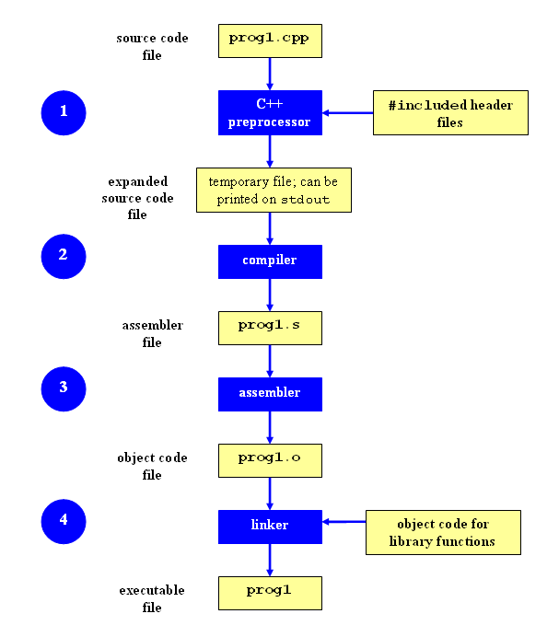
Lexical elements
Identifiers: case sensitive
nCount, strName, Strname
Reservered words
if, else, while
Operators
+, ==, &, &&, ‘? :’
Preprocessor Directives
#include, #if,

Slide 35
Primitive Data Types
Name | Size (bytes) | Description | Range
char | 1 | character or eight bit integer | signed: -128..127 unsigned: 0..255
short | 2 | sixteen bit integer | signed: -32768..32767 unsigned: 0..65535
long | 4 | thirty-two bit integer | signed: -2³¹ .. 2³¹-1 unsigned: 0 .. 2³²
int | * (4) | system dependent, likely four bytes or thirty-two bits | signed: -32768..32767 unsigned: 0..65535
float | 4 | floating point number | 3.4e +/- 38 (7 digits)
double | 8 | double precision floating point | 1.7e +/- 308 (15 digits)
long double | 10 | long double precision floating point | 1.2e +/- 4932 (19 digits)
bool | 1 | boolean value false → 0, true → 1 | {0,1}

Slide 36
Variables declaration & assignments
#include<iostream>
using namespace std;
int main()
{
int i,j,k;
int l;
i=10;
j=k=l=20; //j=(k=(i=20))
cout<<"i="<<i<<endl;
cout<<"k="<<k<<endl;
cout<<"l="<<l<<endl;
i+=10; //i = i + 10;
i++; //i = i + 1;
cout << "i="<<i<<endl;
}
2.cpp

Slide 37
Expressions
Boolean expressions
== , != , >, >=, < , <=, …
&& , || …
Arithmetic expression
+ , - , *, / ,% …
&, | …
Assignment
=
? :
Expressions have values

Slide 38
Example of expressions
7 && 8
7 & 8
7 / 8
7 % 8
7 >> 1
(i > 127 ? true : false)
(i > 127 ? i-127 : i)
3.cpp 4.cpp

Slide 39
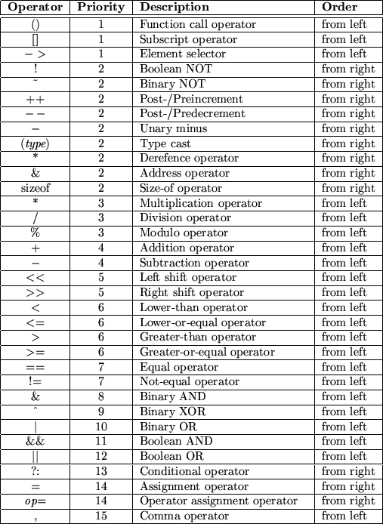

Slide 40
Statements
Assignments
Conditional
Loop
Goto,break,continue
Compound statement

Slide 41
Conditional
if A B ;
if A B else C
If ( I > 10) {cout<<“ > 10”;} else {cout<<“ < 10”;}
5.cpp

Slide 42
Loop, for
for (A;B;C) D
1 execute A
2 execute B
3 if the value of B is false(==0), exit to D
4 execute C, goto 2
for(i=0; i<n; i++){cout << A[i]<<endl;}
for(;;) {…}

Slide 43
Loop, while & do while
while A B
While (i>10) { x-=4;i--;}
do A while B
do {x -=4;i--} while (i>10);

Slide 44
Goto,break,continue
For (; ;){
…
If (a==b) break;
…
}
C
-----------------------------------------
-----------------------------------------
For (;;){
{B}
If (a==b) continue;
{A}
}

Slide 45
switch
switch (grade){
case ‘A’:++nACount;break;
case ‘B’:++nBCount;break;
case ‘C’:++nCCount;break;
case ‘D’:++nDCount;break;
default: cout<<“Something wrong\n”;break;
}
Try: write a program using the code segment. Then remove several of the ‘break’s and see the difference

Slide 46
functions
Can not define a function within another function*
Parameters passed by value or reference

Slide 47
Example
#include<iostream>
using namespace std;
int square (int);
int main ()
{
int z = 4;
cout << square(z);
}
int square (int x)
{ x = (x*x); return x; }
6.cpp

Slide 48
Pass by value
void swap1(int x,int y)
{
int temp=x;
x = y;
y=temp;
}

Slide 49
Pass by reference
void swap2(int& x,int& y)
{
int temp=x;
x = y;
y=temp;
}
7.cpp

Slide 50
Array in C/C++
Definition
Int a[10]; //int[10] a;
Char b[12];
No bounds checking
The cause of many problems in C/C++

Slide 51
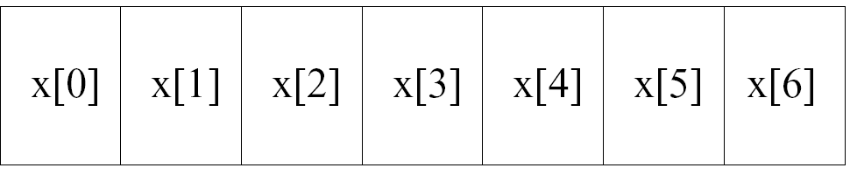
Array
Int x[7];
Int score[3][3]={{1,2,3},{2,3,4}{3,5,6}};

Slide 52
Array: confusing
What is the result of the program.
So, array is passed by reference?
8.cpp

Slide 53
Pointer
Example
int *p, char * s;
The value of a pointer is just an address.
Why pointers?
Dereferencing (*)
Get the content
Referencing (&)
Get the address of

Slide 54
Examples of pointer
int *p;
Int a;
a=10;
p=&a;
*p=7;
Int b=*p;
You must initialize a pointer before you use it
81.cpp 82.cpp

Slide 55
Array and pointer
9.cpp

Slide 56
arithmetic of pointer
Suppose n is an integer and p1 and p2 are pointers
p1+n
p1-n
p1-p2
91.cpp

Slide 57
Strings
C
A string is an array of chars end with ‘\0’
char name[]=“ABC”;
char school_name[]={‘N’,’Y’,’U};
C++ library: string class
10.cpp 101.cpp

Slide 58
Dynamic allocating memory
new , delete
int *p=new int;
int *p=new int [12];
delete p;
delete []p;
malloc,…
11.cpp (difference between different implementations)

Slide 59
Course organization
C++ programming basics
4 h | Course on C++
2h |  | Fundamentals of C++
1h10min |  | Class & inheritance
40min |  | Overloading & overriding
10min |  | Error handling,…

Slide 60
Struct:
struct person
{ long nId;
char strName[30];
int nAge;
float fSalary;
char strAddress[100];
char strPhone[20]; };
struct person a , b, c;
struct person *p;
12.cpp

Slide 61
union
union num
{
int x;
float y;
}
13.cpp

Slide 62
More in a stucture: operations
struct box
{
double dLength,dWidth,dHeight;
double dVolume;
double get_vol()
{
return dLength * dWidth * dHeight;
}
}
14.cpp 141.cpp

Slide 63
Class
class box
{
double dLength,dWidth,dHeight;
double dVolume;
public:
double vol(){return dLength * dWidth * dHeight;}
}
15.cpp

Slide 64
Public vs. private
Public functions and variables are accessible from anywhere the object is visible
Private functions and variable are only accessible from the members of the same class and “friend”
Protected

Slide 65
class
class box
{
double dLength,dWidth,dHeight;
double dVolume;
public:
double vol() ;
}
double box::vol()
{
return dLength * dWidth * dHeight;}
}
16.cpp

Slide 66
Constructors
A special member function with the same name of the class
No return type (not void)
Executed when an instance of the class is the created
17.cpp

Slide 67
Deconstructors
A special member function with no parameters
Executed when the class is destroyed
18.cpp

Slide 68
Tricky
What is the result of the program
19.cpp
How many times the constructor executed?
How many times the deconstructor executed
Examples 20.cpp 21.cpp

Slide 69
Empty constructor & Copy constructor
Empty constructor
The default constuctor with no parameters when an object is created
Do nothing: e.g. Examp::Examp(){}
Copy constructor
Copy an object (shallow copy)
The default constructor when an object is copied (call by value, return an object, initialized to be the copy of another object)
22.cpp {try not to pass an object by value)

Slide 70
Inheritance
Base class
Derived class
23.cpp
Protected members
24.cpp

Slide 71
Constructors
28.cpp

Slide 72
Inheritance
base
derived
Public inheritance
public
public
protected
protected
private
N/A
Private inheritance
public
private
protected
private
private
N/A
Protected
inheritance
public
protected
protected
protected
private
N/A

Slide 73
Static members in class
Static variables
Shared by all objects
Static functions
Have access to static members only
Static members can be accessed by the class name
29.cpp

Slide 74
Friend functions
Have access to the private members of a class.
Must be declared as friend in that class.
Why friend functions?
efficiency
30.cpp 31.cpp 32.cpp

Slide 75
Friend class
A class can be declared as the friend of another class.

Slide 76
Course organization
C++ programming basics
4 h | Course on C++
2h |  | Fundamentals of C++
1h10min |  | Class & inheritance
40min |  | Overloading & overriding
10min |  | Error handling,…

Slide 77
Function overloading
Define several functions of the same name, differ by parameters.
void Show()
void Show(char *str)
Void show(int x)
33.cpp

Slide 78
Function overloading
Must have different parameters
int func1(int a, int b);
double func1(int a, int b);
void func(int value);
void func(int &value);
Static binding
The compilers determine which function is called.
(Often used for the multiple constructors)

Slide 79
Operator overloading
Define new operations for operators (enable them to work with class objects).
+ - * / = < > += -= *= /= << >> <<= >>= == != <= >= ++ -- % & ^ ! | ~ &= ^= |= && || %= [] () new delete
Class date x ,y
x+y x-y x>y, x&y

Slide 80
Special member functions
Ret_type class_name::operator<>(arg_list)
34.cpp

Slide 81
Overloading summary
Same name
Different parameters
Static binding (compile time)
Anywhere

Slide 82
Virtual function & overriding
Define a member function to be virtual
Use pointer/reference/member functions to call virtual functions
Dynamic binding
Time consuming
The constructor cannot be virtual
Must be a member function

Slide 83
Virtual functions examples
By pointers 42.cpp
By reference
By member function of the base class

Slide 84
Overloading & overriding
Polymorphism
Static and dynamic
Compile time and running time
Parameters
Anywhere / between the base and derived class

Slide 85
Pure virtual functions & abstract class
Pure virtual functions
A function declared without definition
virtual ret_type func_name(arg_list)= 0;
Abstract class
A class contains one or more pure functions
Can not be instantiated
Can be used to define pointers

Slide 86
Course organization
C++ programming basics
4 h | Course on C++
2h |  | Fundamentals of C++
1h10min |  | Class & inheritance
40min |  | Overloading & overriding
10min |  | Error handling,…

Slide 87
Exceptions
try
{ // code to be tried
throw exception; }
catch (type exception)
{ // code to be executed in case of exception }

Slide 88
Examples of exception
54.cpp
throw out an object.
55.cpp

Slide 89
Uncaught exception
Uncaught exceptions will be thrown into outer scope.
If no catch, usually program will terminate.
Void terminate();

Slide 90
Powered by trust : la confiance est notre moteur
Safran Engineering Services/ Confidentiel / Juin 2016/ Commerce

